Slide 1
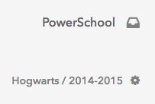
Homepage
Today’s date
Today’s attendance data at a glance
Notes:
-Your screen will look different than mine because you don’t have any data in the site yet since the school year hasn’t started yet. Since you’ll all be taking attendance in SR, this is what you can expect to see once you start tracking data in Schoolrunner.

Slide 2
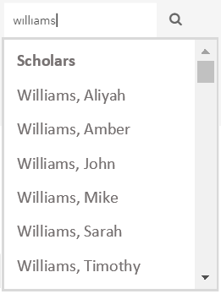
Searching For a Student
Two ways to search for a student and get to their profile page:
Click on a student’s name anywhere in the site it appears as an orange hyperlink: Williams, Mike
Click on the magnifying glass at the top of the screen and type any part of the student’s name or their 6-digit ID #. You can also search for courses and assessments this way.
Notes:
Wherever you see a student’s name in orange, it’s actually a hyperlink to their profile page. You can hover your mouse over their name and you should see a popup box with some quick info about them (demographics, bus stop, contact info). You can also click on their name to go directly to their student page.
Magnifying glass – “quick search” – just type any part of what you’re searching for (students, staff, assessments, courses, student groups)

Slide 3
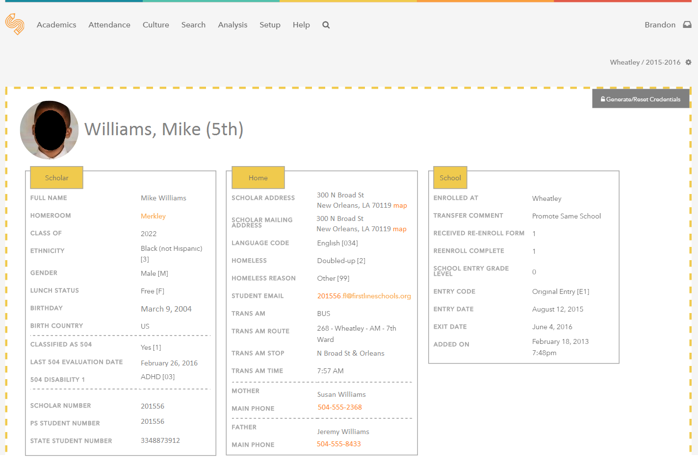
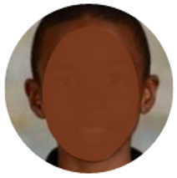
The Student Page (Top Half)
Notes:
Contains demographic and contact information. Also contains information related to 504/SPED disability and medical alerts. Some of the boxes might be longer or in a different position depending on the amount of information they contain. Scroll down to see more info (grade, attendance, behaviors, etc.).

Slide 4
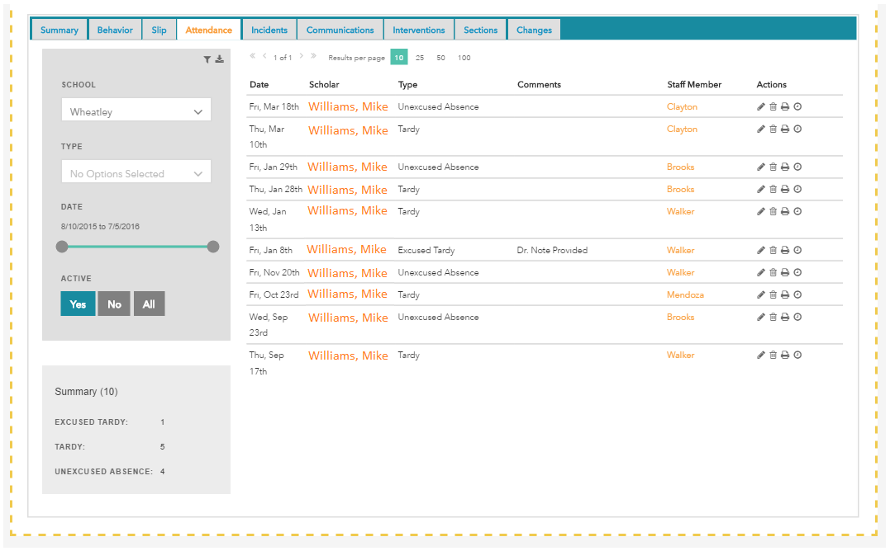
The Student Page (Bottom Half)
Download records
Filter records
Print records

Slide 5
Questions about the homepage or student page?

Slide 6
Taking Attendance
Must be done accurately, on time, everyday.
Why?
1. It’s the law
2. Student safety
3. Funding
4. Helps maintain accurate rosters
Notes:
Ask participants why they think it’s important before giving list of reasons.

Slide 7
Taking Attendance
Attendance can be taken once a day (typically in homeroom) or in each class period, depending on school policy.
Exact procedures (what time attendance needs to be taken, how tardy students are handled, etc.) vary slightly from school to school.

Slide 8
Taking Attendance
Hover over Attendance
Click Class Attendance
(Daily Attendance page is used mainly by front office)
Notes:
Mention that there is also a mobile app where you can take attendance and I’ll be providing a handout that goes through how to do this step-by-step.

Slide 9
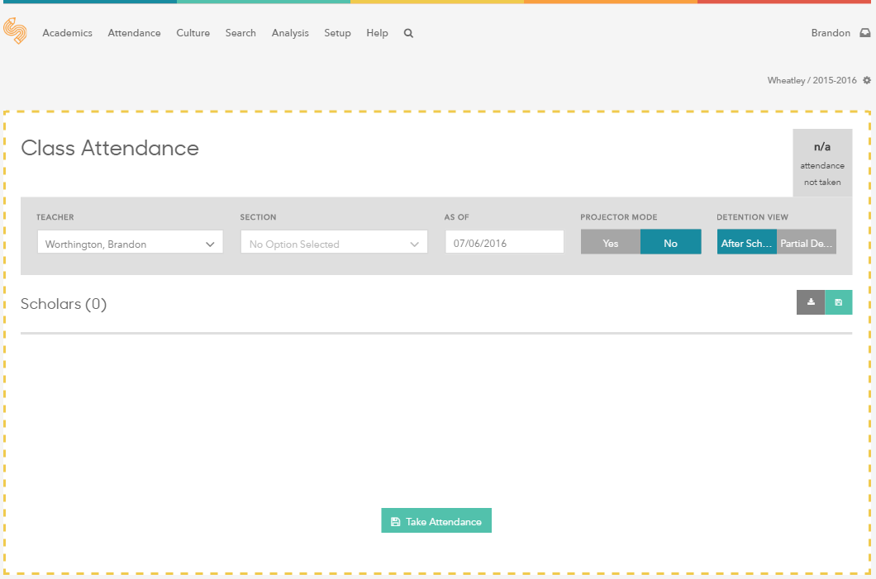
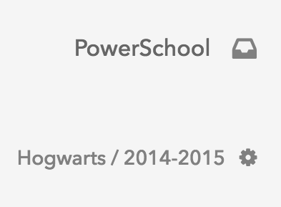
Taking Attendance
Normally, you should see your class roster automatically appear below
No class linked to my name on this date, so no roster appears
Defaults to your name
Defaults to your section/class for the current class period
Defaults to today’s date
Can select any teacher’s class to take attendance (helpful for subs & teachers)

Slide 10
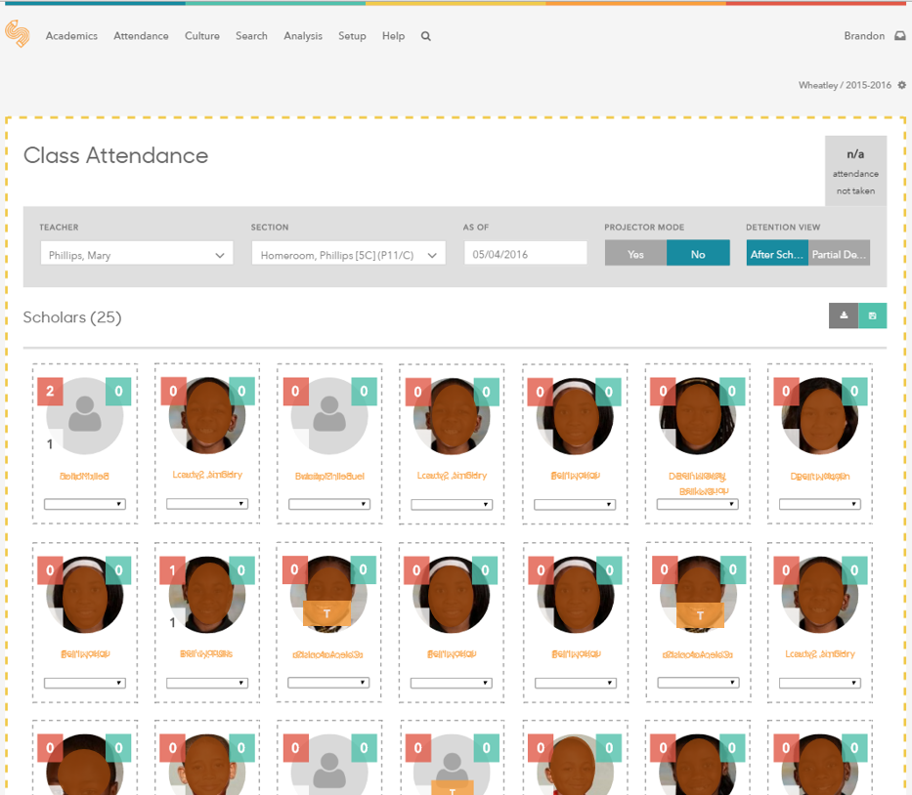
Taking Attendance

Slide 11
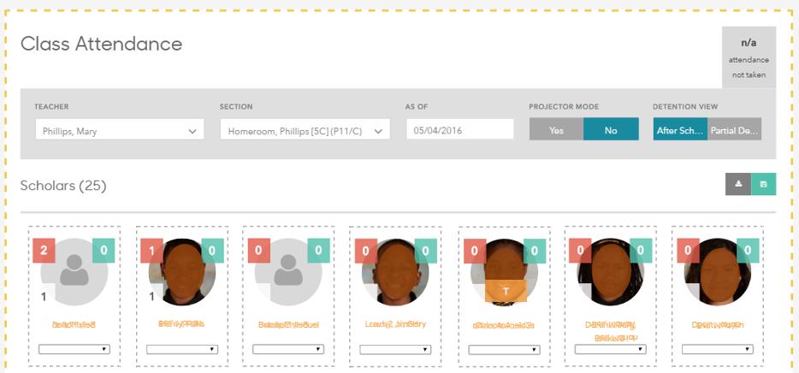
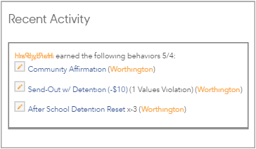
Taking Attendance
Attendance not taken yet
What does all of this mean?
Yes = removes grades & behaviors
Number of positive & negative behaviors earned so far today (hover over number for details)
Already marked tardy by front office

Slide 12
Taking Attendance
Update attendance code for ALL students – click on face or dropdown menu to change attendance
Students have no code by default

Slide 13
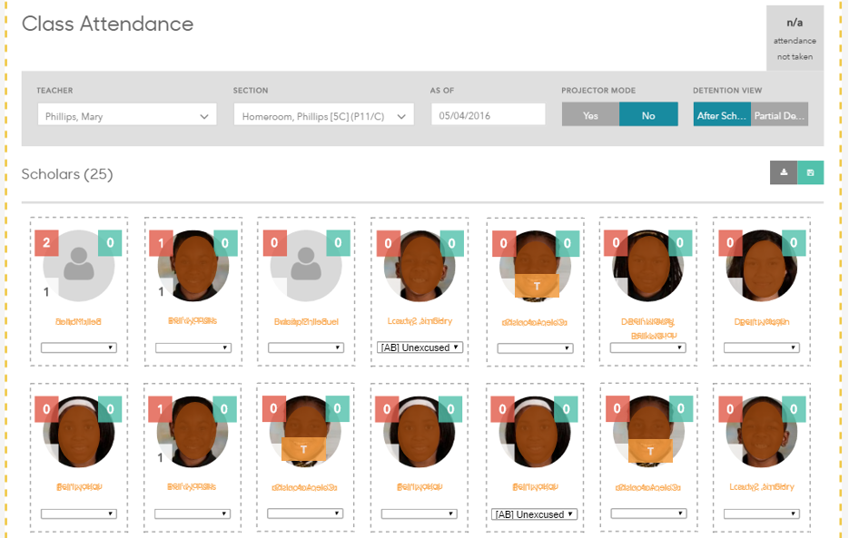
Taking Attendance
Be sure to click green save button or “Take Attendance”
Notes:
MUST click save or “take attendance” in order for attendance to be submitted. Still possible to make an edit after clicking Save- just make the change and click save again.

Slide 14
Taking Attendance
Success notification:
Class Attendance = attendance just for this class period (1st period/homeroom in this case)
Daily Attendance = students’ attendance for the whole day (Daily attendance is based on 1st period/homeroom)
Notes:
Look for this notification after submitting attendance.

Slide 15
Questions about taking attendance?

Slide 16
PracPractice Timetice Time
Practice Time: Attendance
If there are no class sections tied to your name, “x” out of the teacher name and select any class section from the dropdown.
Give every student in your section an attendance code. Practice taking (and saving!) attendance for your section.

Slide 17
Logging Behaviors
Behaviors can be positive (merits, points, habits), negative (demerits, off-points, deductions), or neutral.
Ties in with students’ slips/paycheck balance.
Does NOT include severe misbehaviors that result in suspensions (called “Incidents” in SR).
Notes:
-Pos & neg behaviors can be called whatever language your school uses

Slide 18
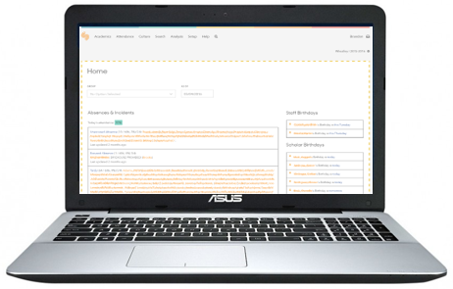
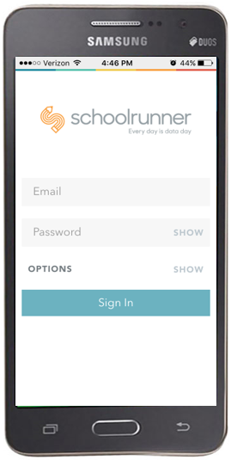
Logging Behaviors
Different workflows:
Clipboard → Schoolrunner
Enter into Schoolrunner in realtime
Behaviors page
Class Attendance page
Mobile app

Slide 19
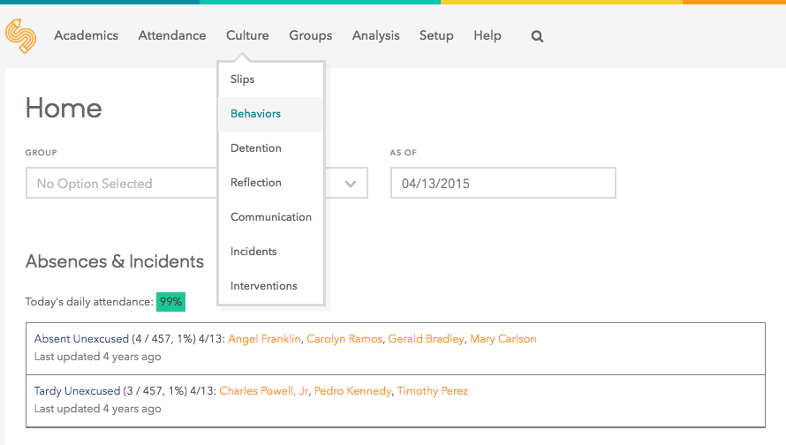
Logging Behaviors (Behaviors Page)
Hover over Culture
Click Behaviors

Slide 20
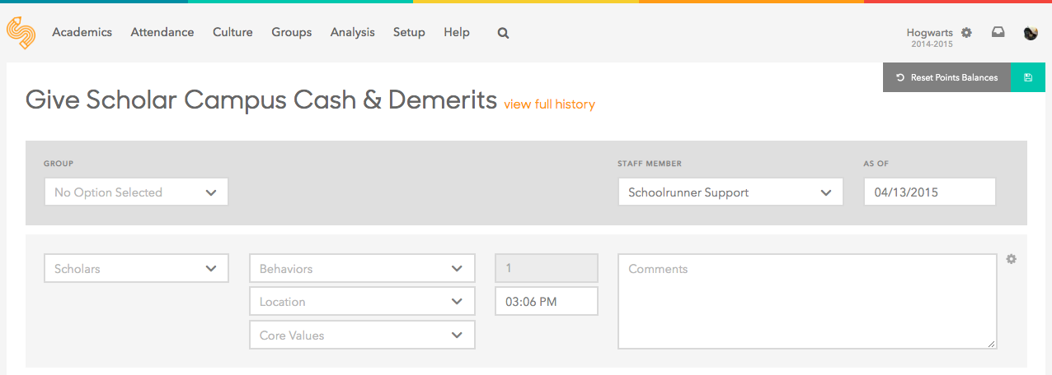
Logging Behaviors (Behaviors Page)
Select which students to receive behaviors (2 options)
Select a whole group of students (homeroom)
Add students individually
Notes:
If date needs to be changed (such as when entering behaviors from day before), you must change the date BEFORE adding any other data

Slide 21
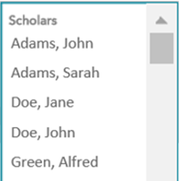
Logging Behaviors (Behaviors Page)
Adding students individually:
Select one or more students from menu
Type student name in menu for easy search
Notes:
First we’re going to see how to add individual students to receive a behavior.

Slide 22
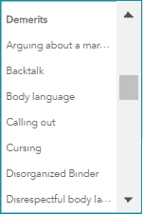
Logging Behaviors (Behaviors Page)
Select one or more behaviors to apply to the selected student(s)
Behavior menus vary by school
Notes:
Also, there could be other school specific menus that you see (e.g., core value menu). Refer to your expert for more guidance on that.

Slide 23
Logging Behaviors (Behaviors Page)
Select a location (optional, depends on school norm)
Type a comment to add details (keep these PROFESSIONAL – they show up on slips and in the parent portal!)

Slide 24
Logging Behaviors (Behaviors Page)
It’s possible to add multiple students to this record if they are receiving the same behavior

Slide 25
Logging Behaviors (Behaviors Page)
Click the gear icon to add a row below so that other behaviors can be added for other students

Slide 26
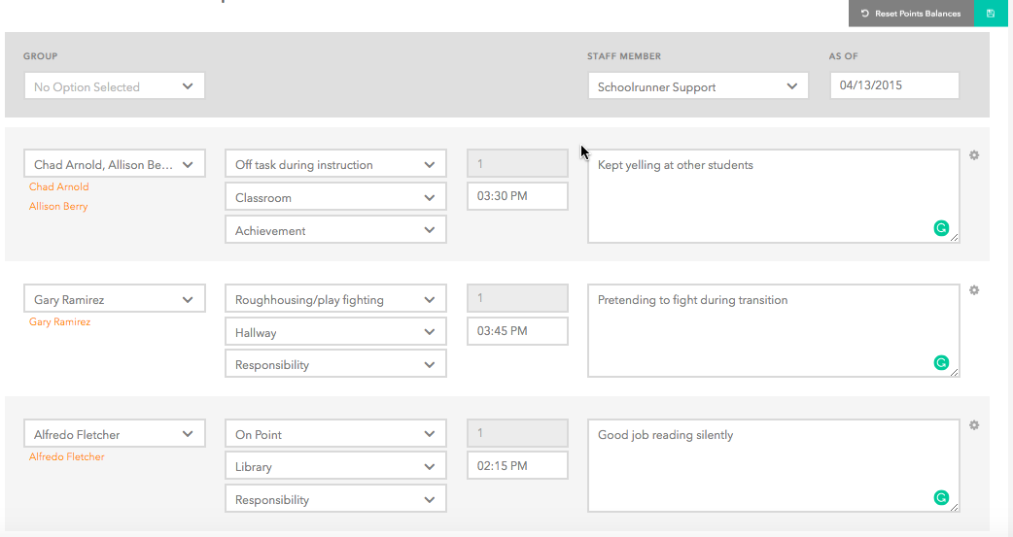
Logging Behaviors (Behaviors Page)

Slide 27
Logging Behaviors (Behaviors Page)
Click save after entering all info
Notes:
Look for notification that behaviors successfully saved.

Slide 28
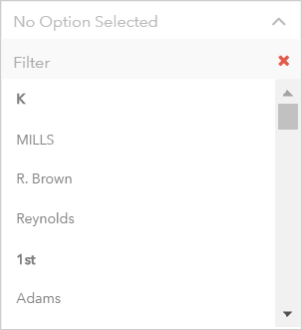
Logging Behaviors (Behaviors Page)
Selecting a group of students to receive behaviors:
Pick a student group from the group menu to see a roster of every student in that group
Groups usually refer to homerooms, but can include custom groups created by teachers or admin
Notes:
Now let’s see how to select a whole group of students that we can add behaviors for.
More on creating custom student groups later…

Slide 29
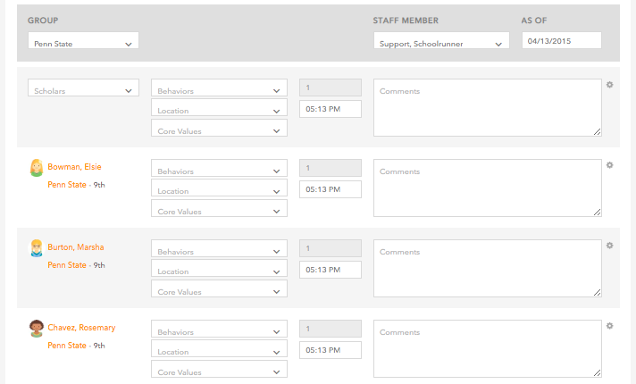
Logging Behaviors (Behaviors Page)
Every student in this group is listed now
Can add zero, one, or multiple different behaviors to each student
Notes:
Deans will provide more guidance on specific academy policies about recording behaviors later.

Slide 30
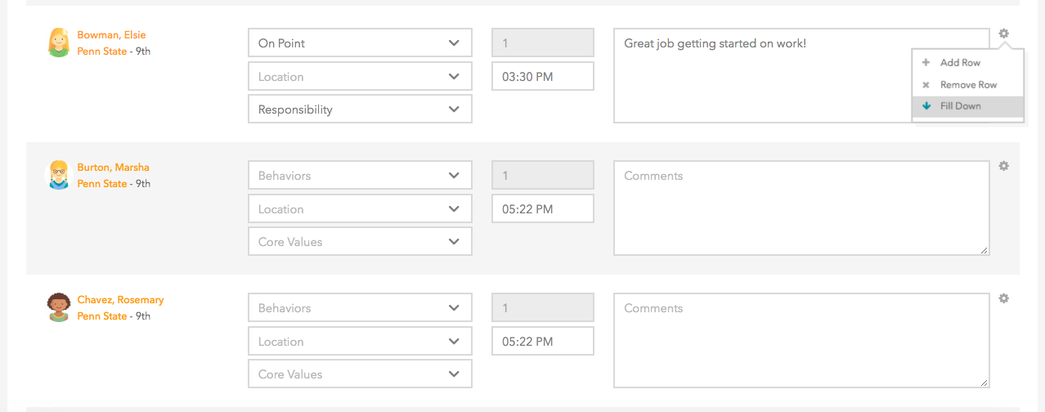
Logging Behaviors (Behaviors Page)
Click the gear icon to apply this row’s behavior and comment to everyone below
Notes:
Mass applying behaviors to a group of students can be an easy way to give everyone in a class positive points. Probably not a good idea to use this feature to give everyone in a class a detention.

Slide 31
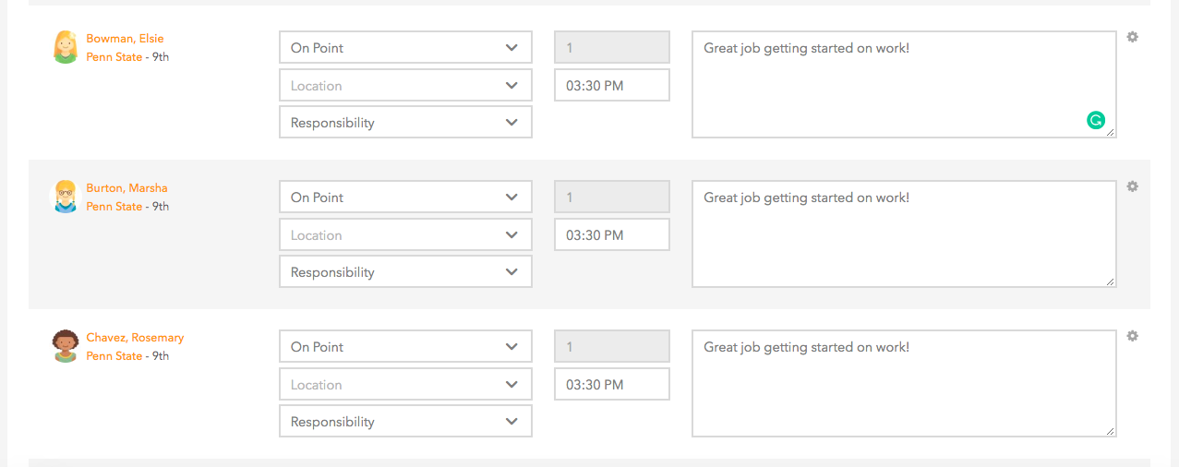
Logging Behaviors (Behaviors Page)
Notes:
Mass applying behaviors to a group of students can be an easy way to give everyone in a class positive points. Probably not a good idea to use this feature to give everyone in a class a detention.

Slide 32
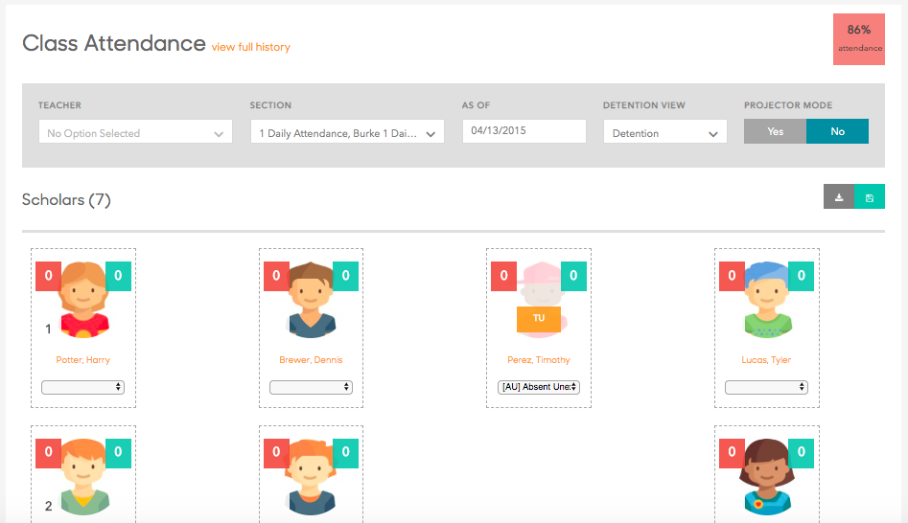
Logging Behaviors (Class Attendance Page)
Click on either of the red or green boxes
Notes:
This method can make entering behaviors more efficient if you’re trying to do it in real time with your laptop in class

Slide 33
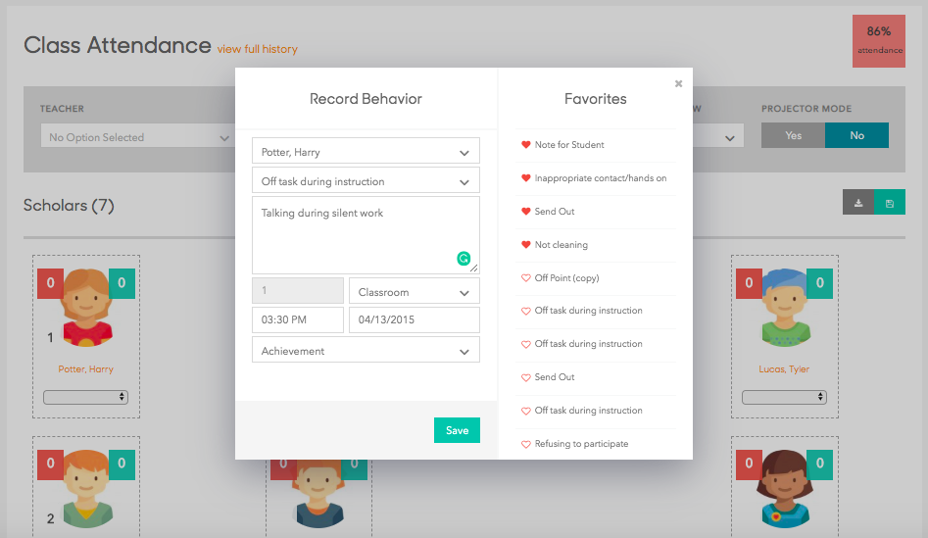
Logging Behaviors (Class Attendance Page)
Notes:
This method can make entering behaviors more efficient if you’re trying to do it in real time with your laptop in class

Slide 34
Practice Time: Behaviors
Log some behaviors for students and student groups via the Behaviors page.
Log some behaviors for students via the Class Attendance page
As a bonus, remember the name of a student you logged a behavior for and then go check out the record on their student page!

Slide 35
Questions about logging behaviors?

Slide 36
Logging Communications
Personalized calls = better attendance!
Specific expectations about when/how often to contact families may vary by school
Whatever communications you do make should be logged… Why?

Slide 37
Logging Communications
Why it’s important to log communications you have with families:
If it isn’t logged, it didn’t happen (truancy, retention)
Make sure all families receive regular calls
Track ratio of positive to negative calls

Slide 38
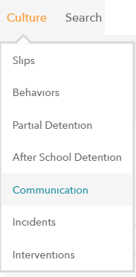
Logging Communications
Hover over Culture
Click Communication

Slide 39
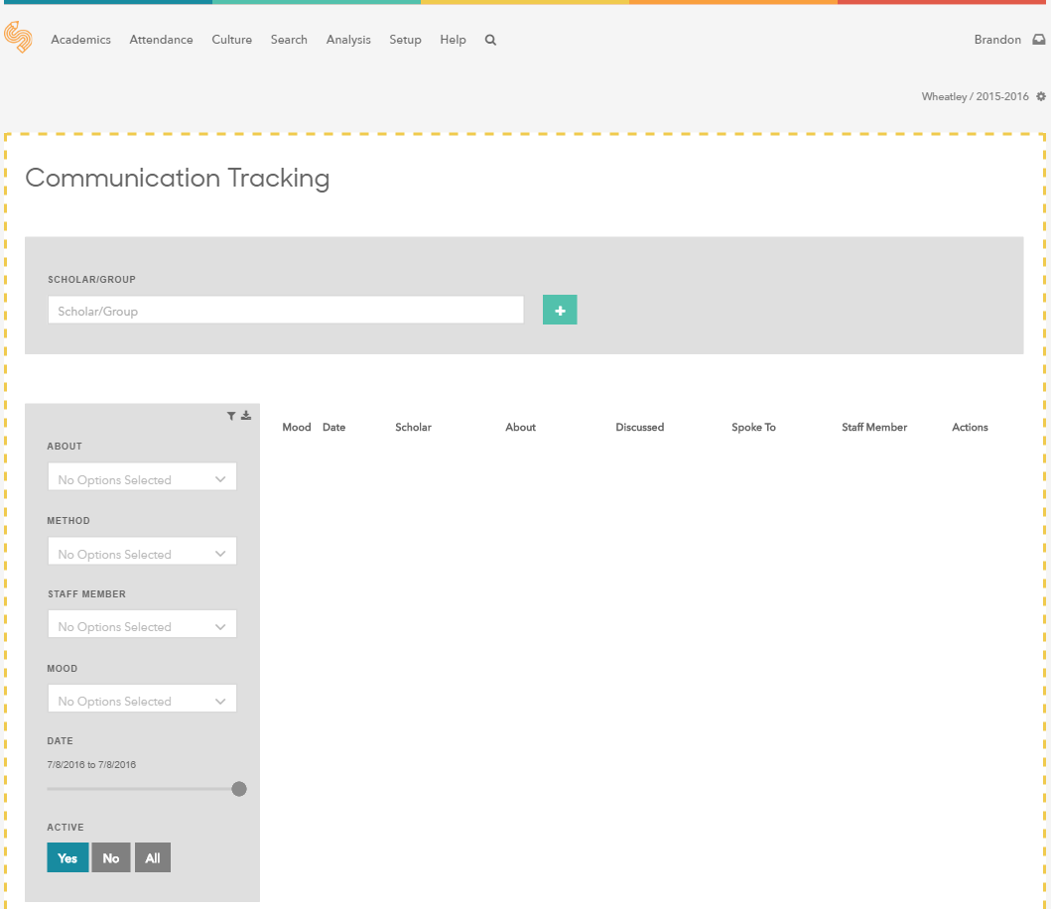
Logging Communications

Slide 40
Logging Communications
Filters to display previous communication logs for all students in this school
Go to Communications tab of student page to view records for one student
Hover over date slider and adjust or pick date range
Notes:
How to view previous communication logs

Slide 41
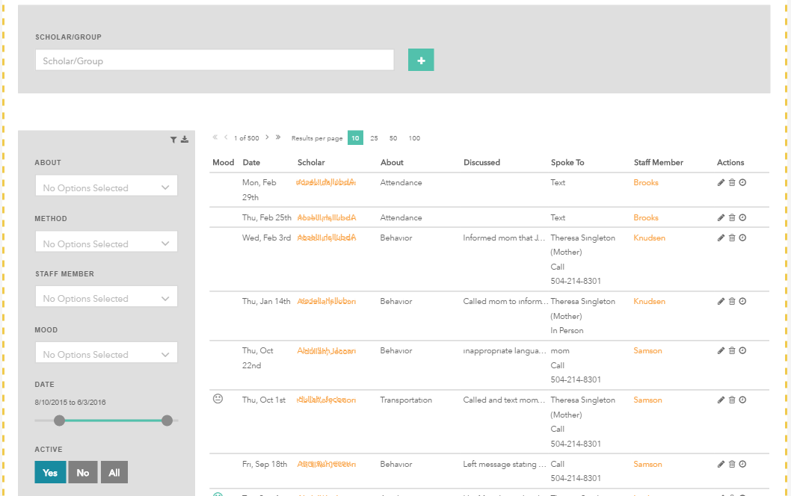
Logging Communications
To log a new communication, select a student or group of students
Notes:
For Bridge Prep, you will be logging for homeroom groups for things like a Remind Message

Slide 42
Logging Communications
Click to start a new log

Slide 43
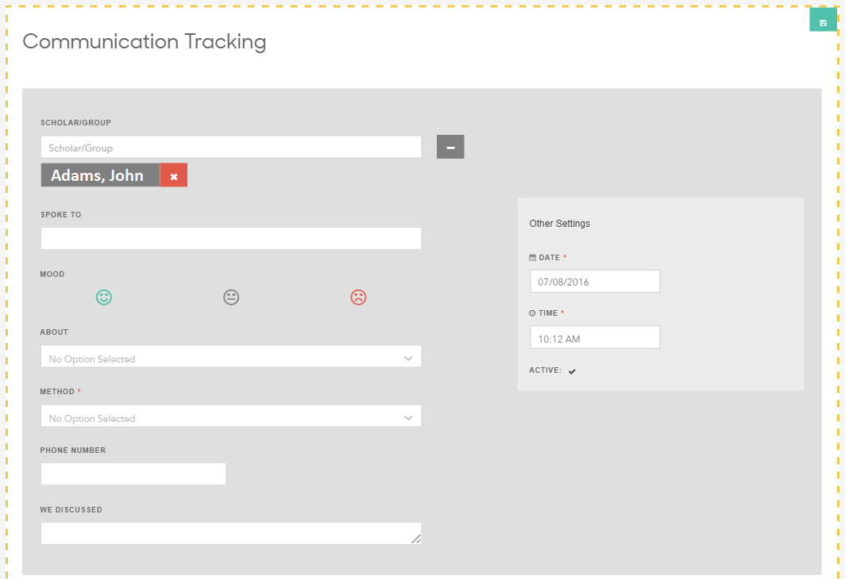
Logging Communications
Be sure to click save
Fill in information about the communication
Confirm date & time of the communication (defaults to current date & time)

Slide 44
Logging Communications

Slide 45
Practice Time: Communications
Log a couple communication records for students for different reasons. Remember to include a comment!
As a bonus, remember the name of a student you logged a communication for and then go check out the record on their student page!

Slide 46
Questions about logging communications?

Slide 47
Creating Assessments
A few different options that we’ll go over:
Option #1: Enter assessment by overall score
Option #2: Enter assessment question-by- question for item analysis

Slide 48
Gradebook Overview
Can enter students’ overall assessment score out of a percentage (0-100%) or level (1-4)
Best place to get a holistic view of how students are performing in courses
Can view performance by assessment, assessment type bucket, or standard
Notes:
-Only assessment types that count toward course grades will be displayed

Slide 49
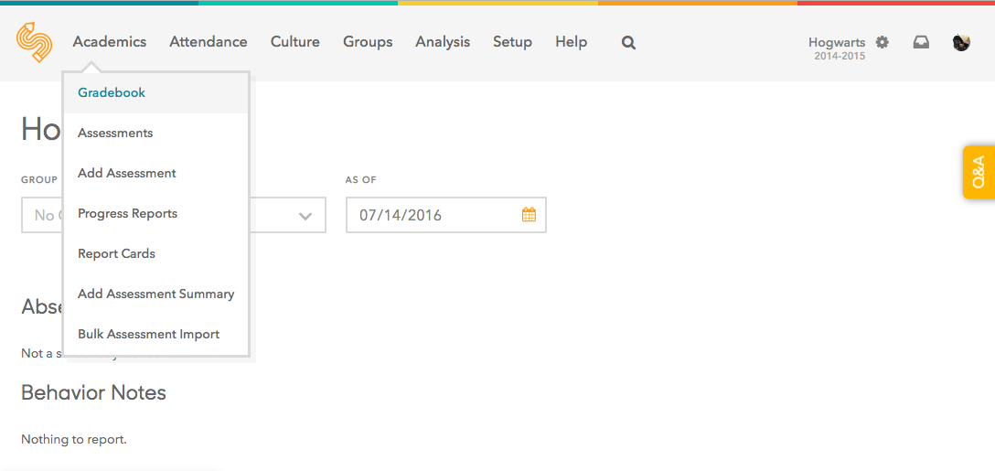
Gradebook
Hover over Academics
Click Gradebook

Slide 50
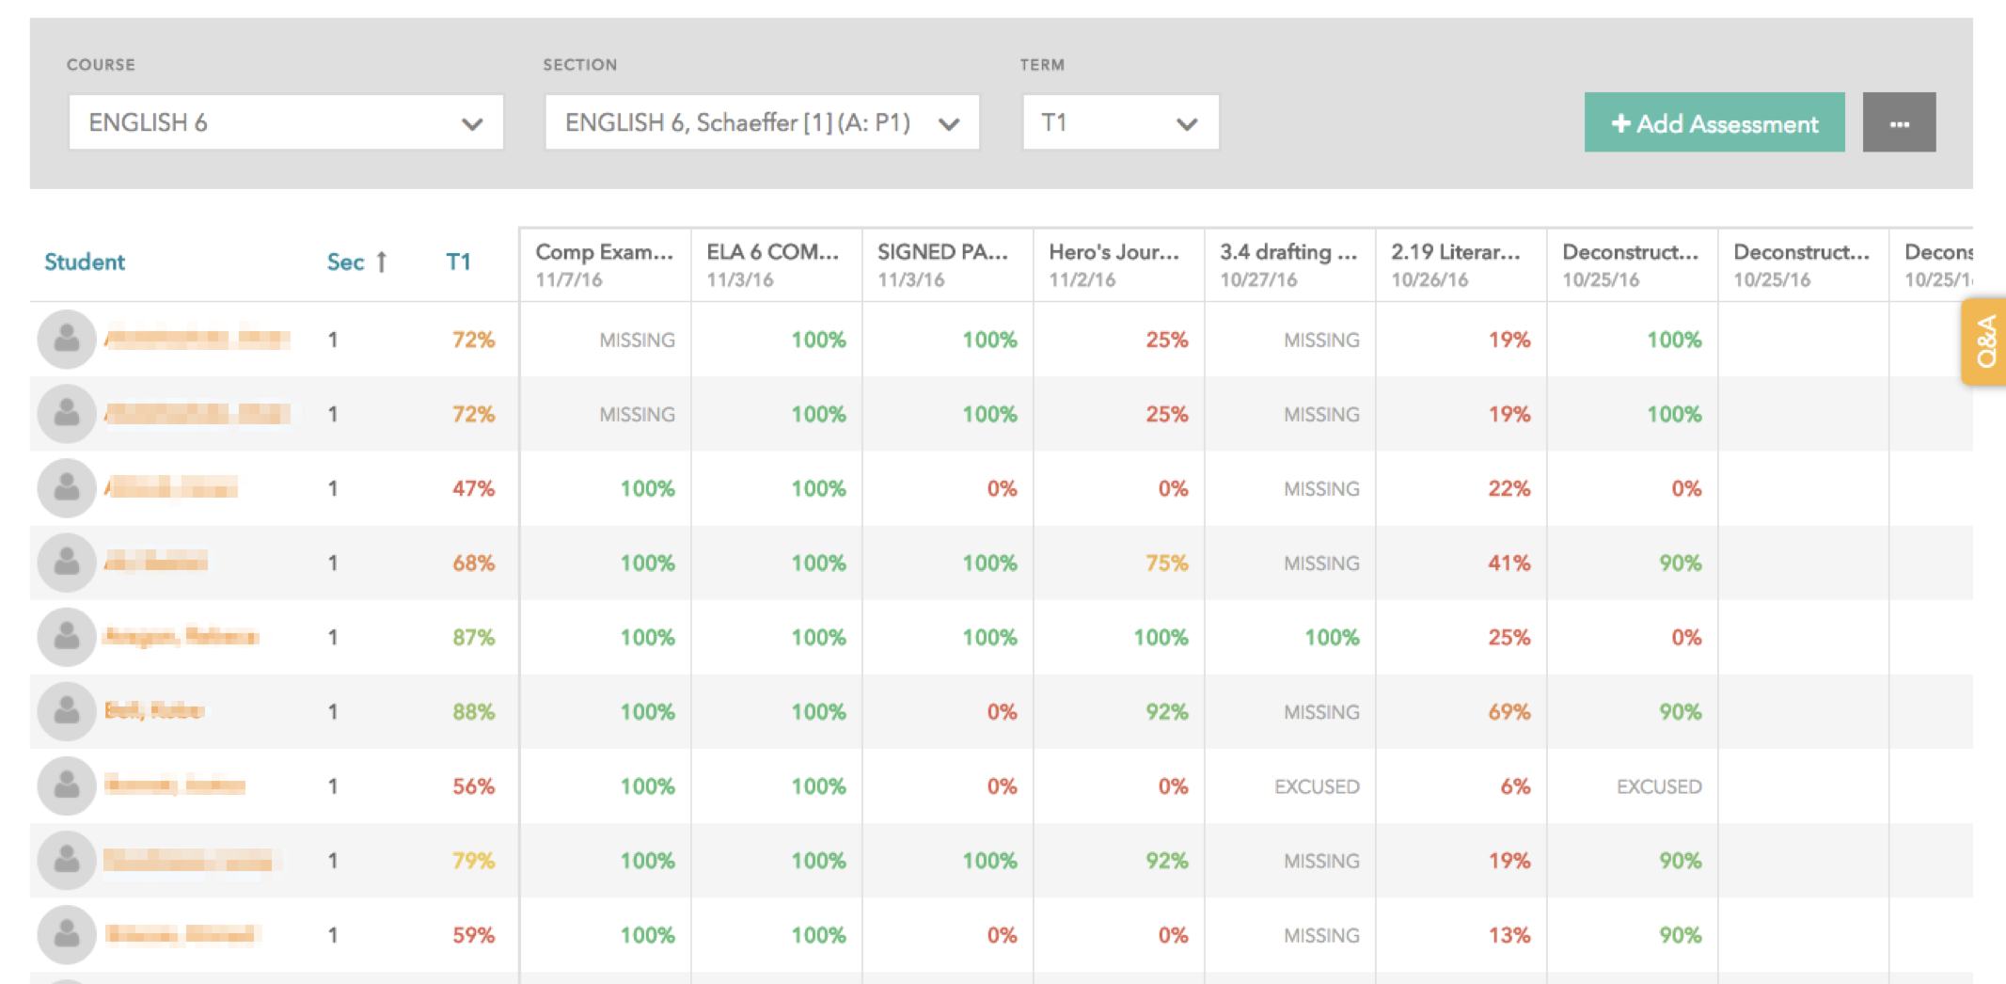
Timeline View

Slide 51
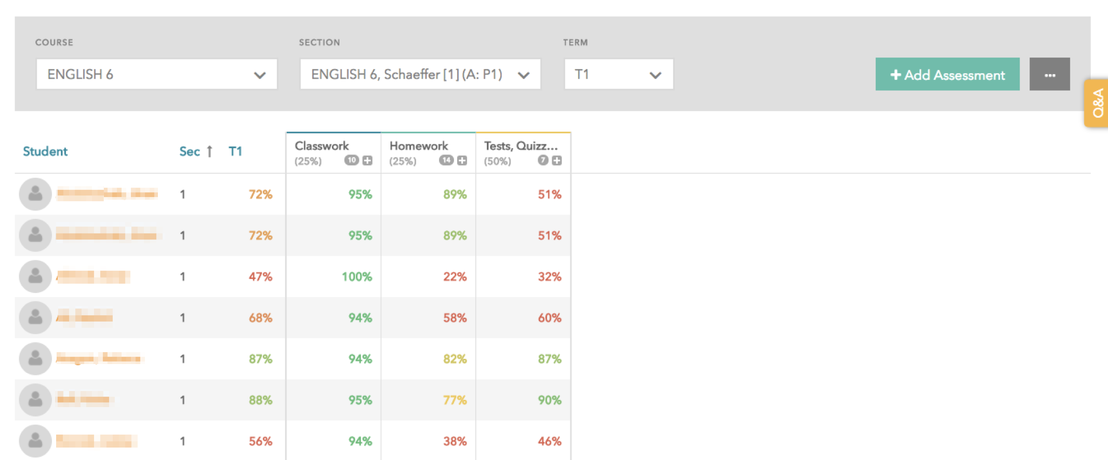
Assessment Type Bucket View

Slide 52
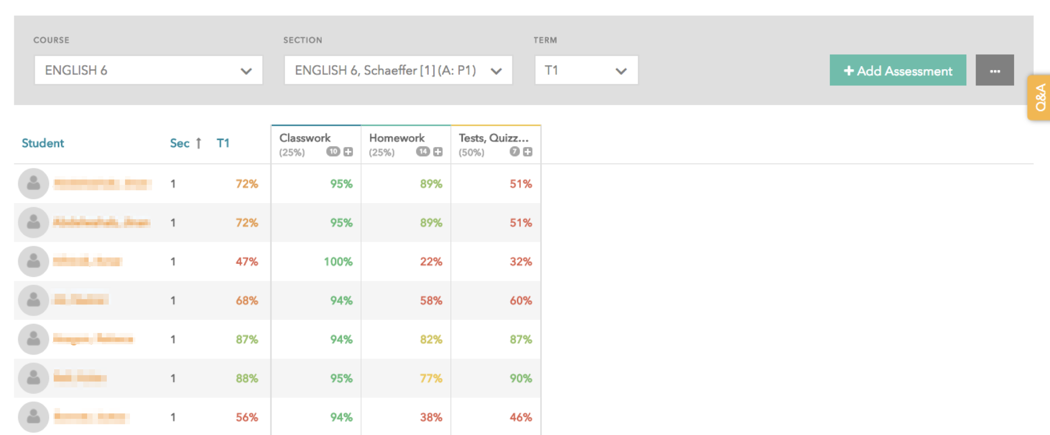
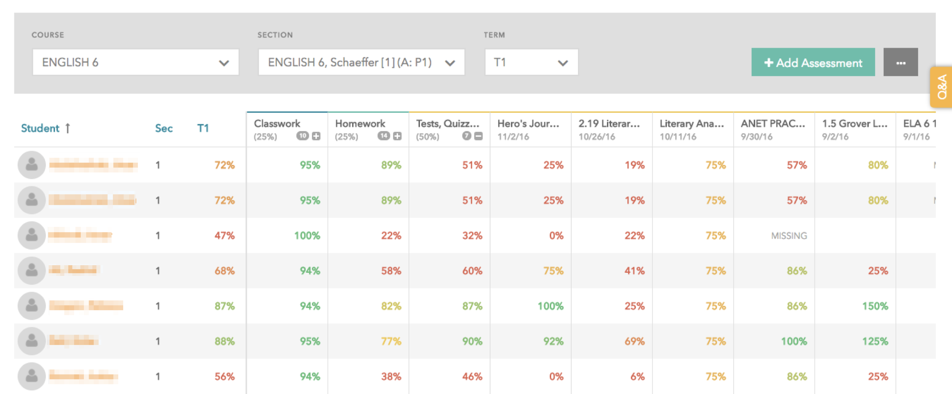
Assessment Type Bucket View- Tests, Quizzes, Projects Expanded Out

Slide 53
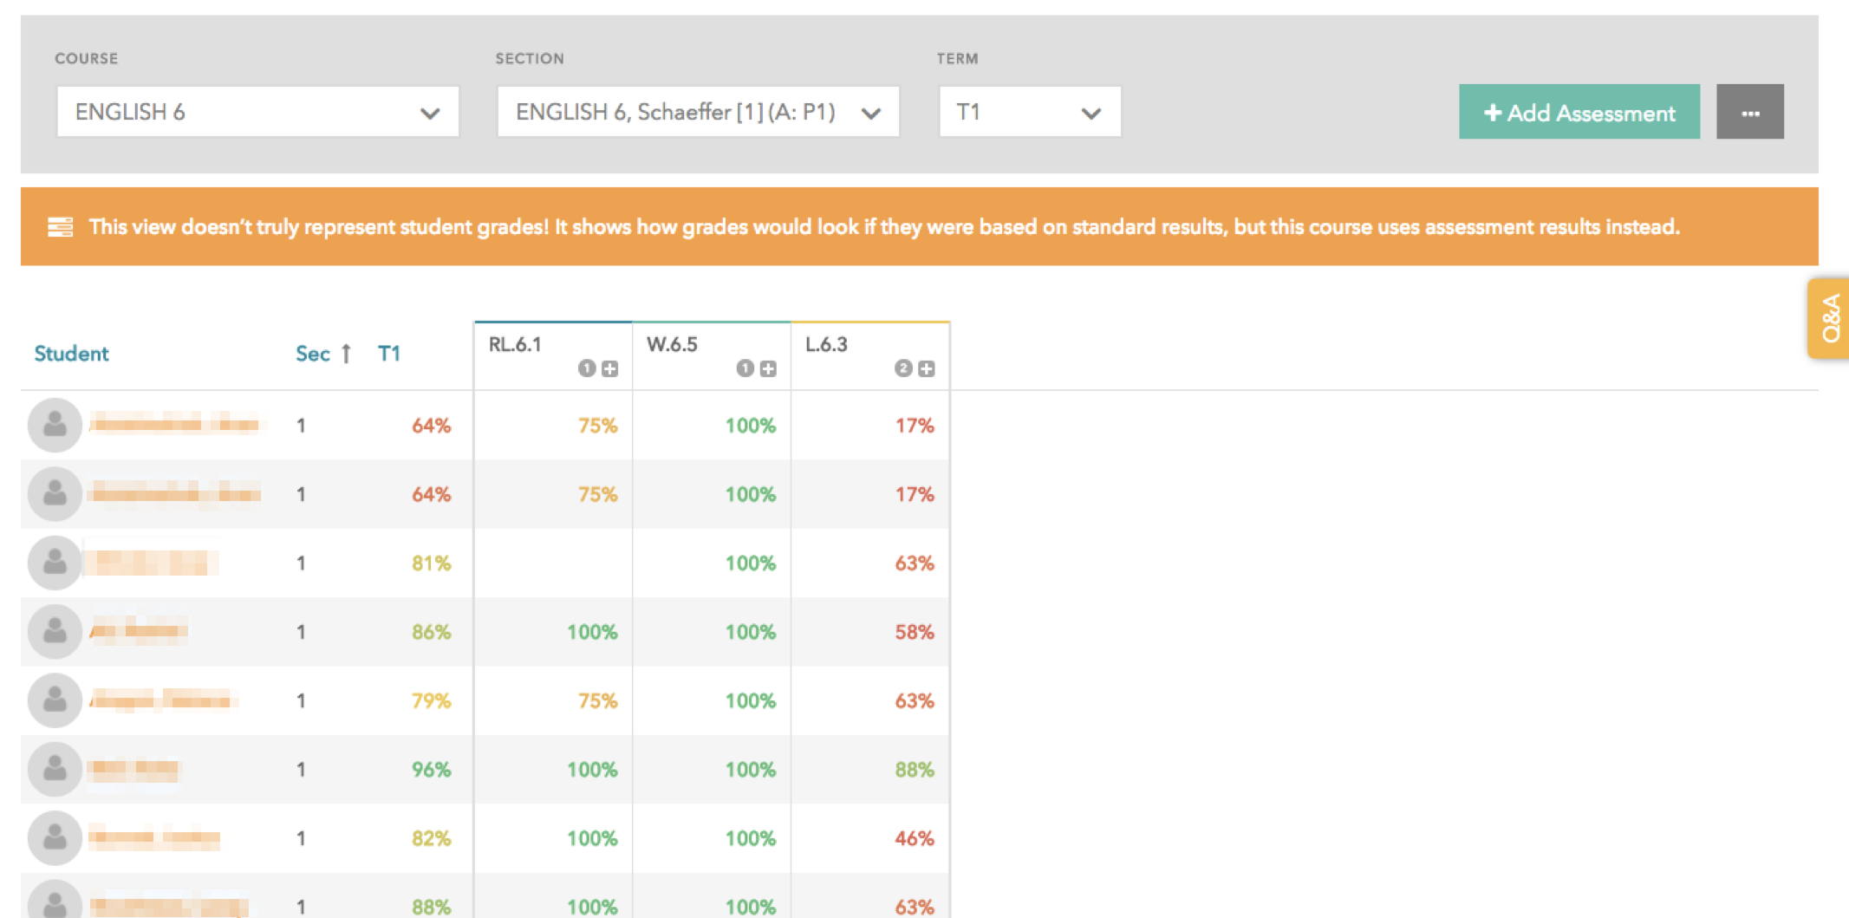
Standard View

Slide 54
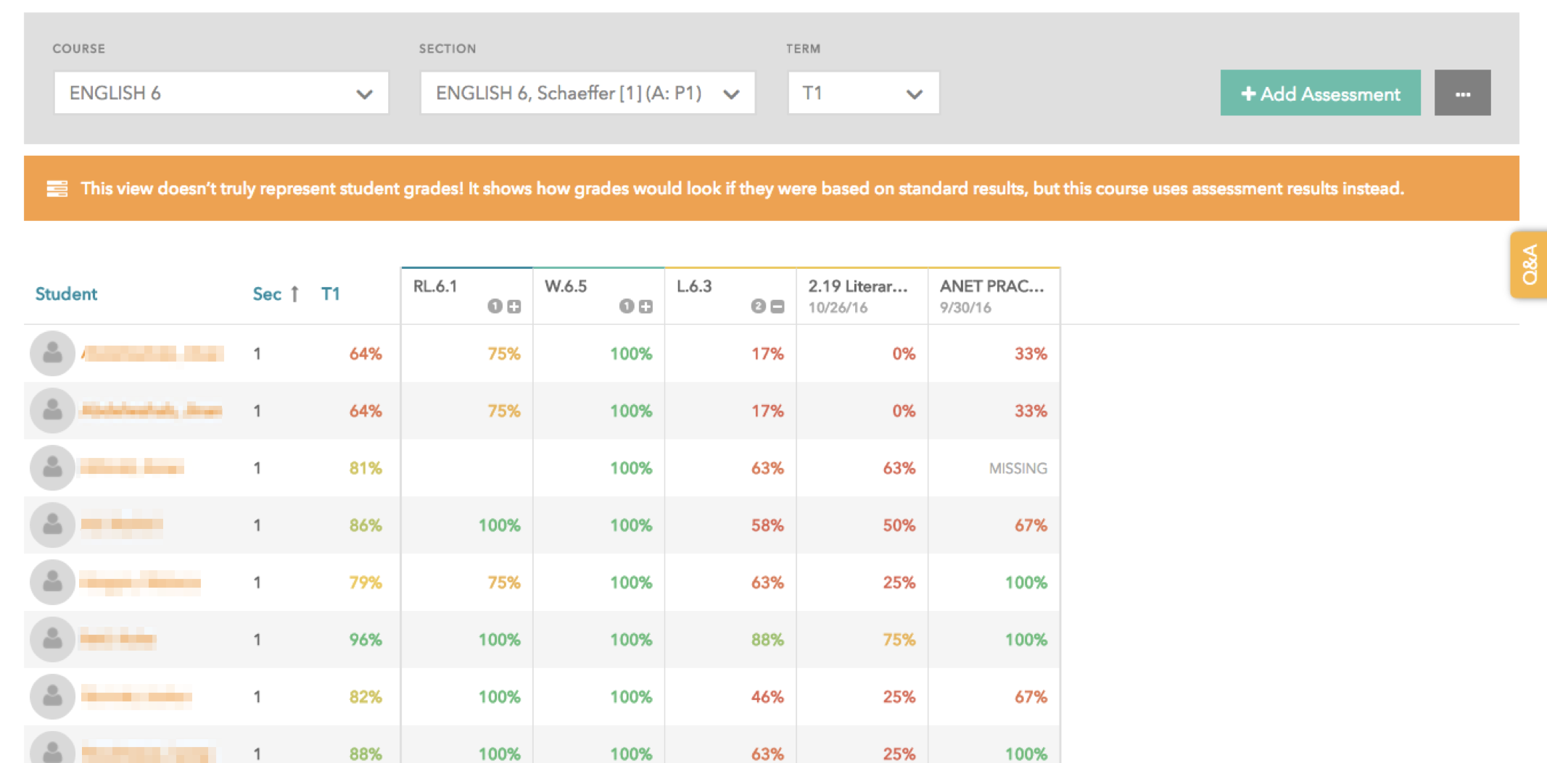
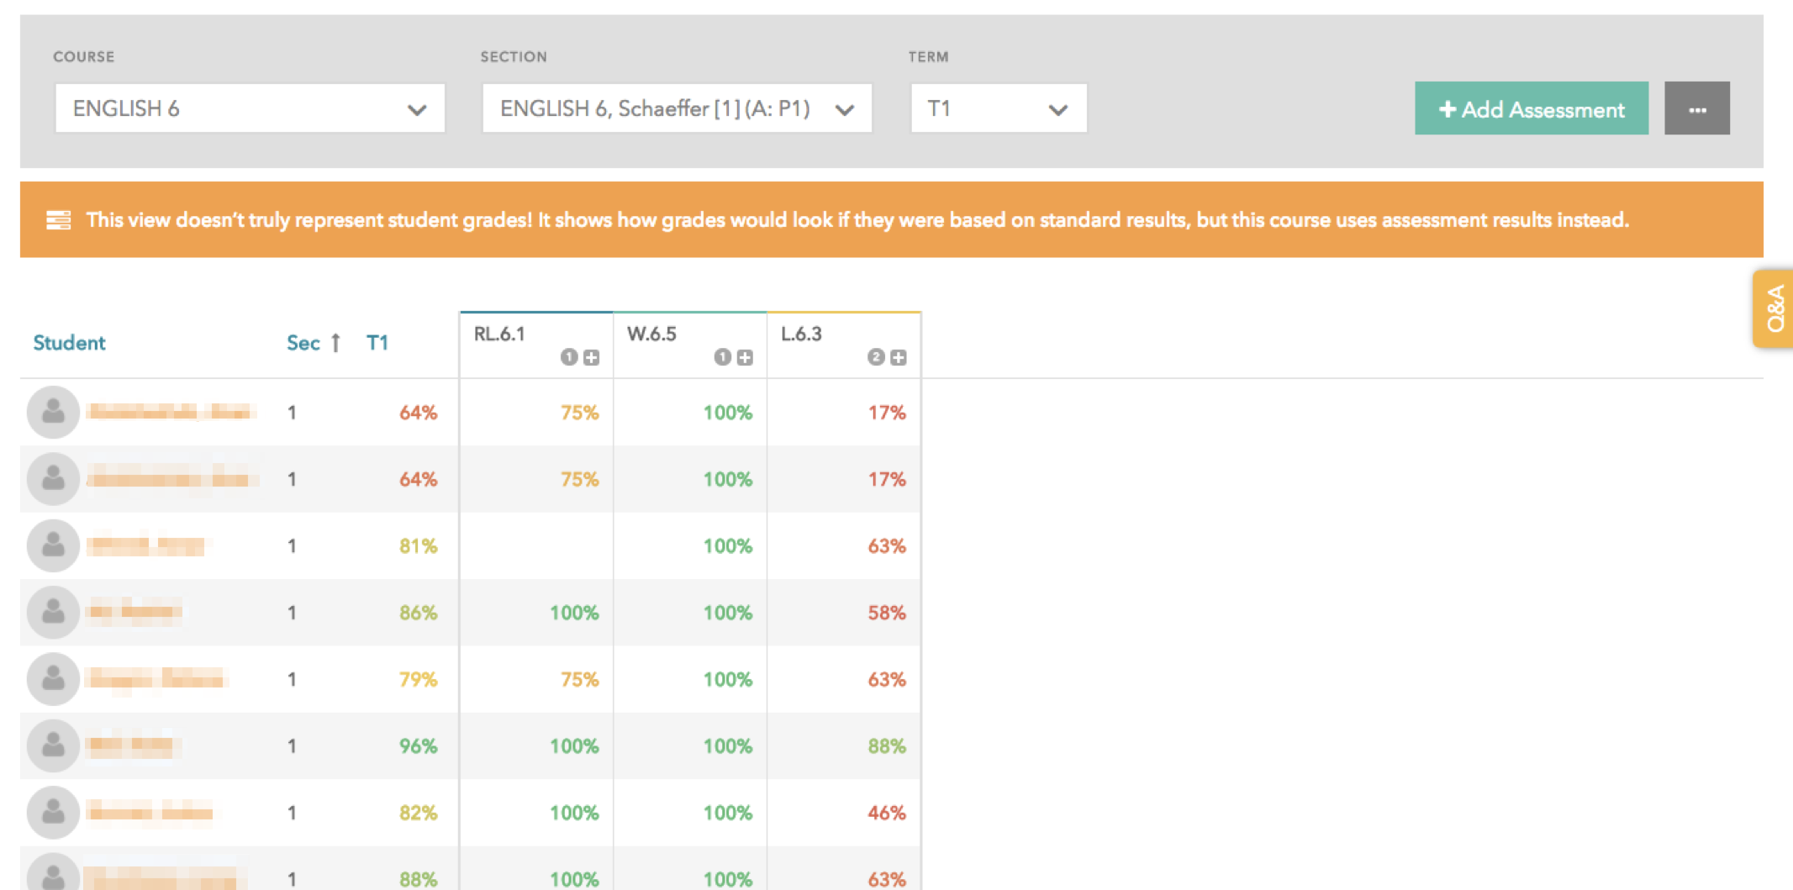
Standard View- L.6.3 Expanded Out

Slide 55
Enter assessment by overall score

Slide 56
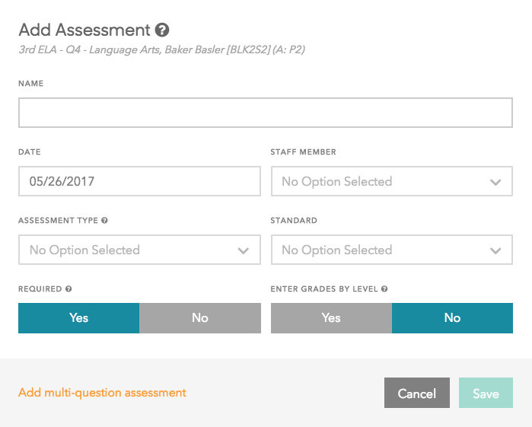
Enter assessment by overall score
Enter a detailed name for the assessment

Slide 57
Enter assessment by overall score
Date of the assessment, today’s date by default (be sure to change this if entering an assessment retroactively)

Slide 58
Enter assessment by overall score
Your name by default

Slide 59
Enter assessment by overall score
Type of assessment

Slide 60
Enter assessment by overall score
Find the standard you’re assessing
(optional- for analysis)

Slide 61
Enter assessment by overall score
If Required = Yes, students without results will be marked as missing

Slide 62
Enter assessment by overall score
Default is No-- toggle to Yes if you will be entering the overall level students should receive as opposed to an overall percentage.

Slide 63
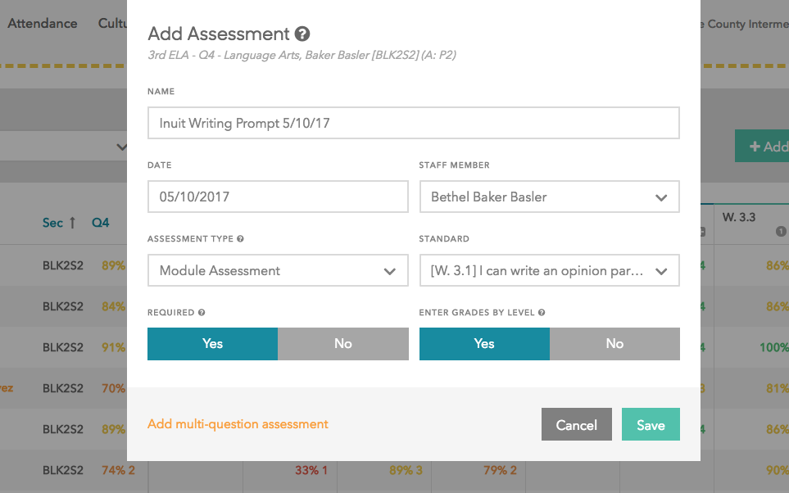
Enter assessment by overall score

Slide 64
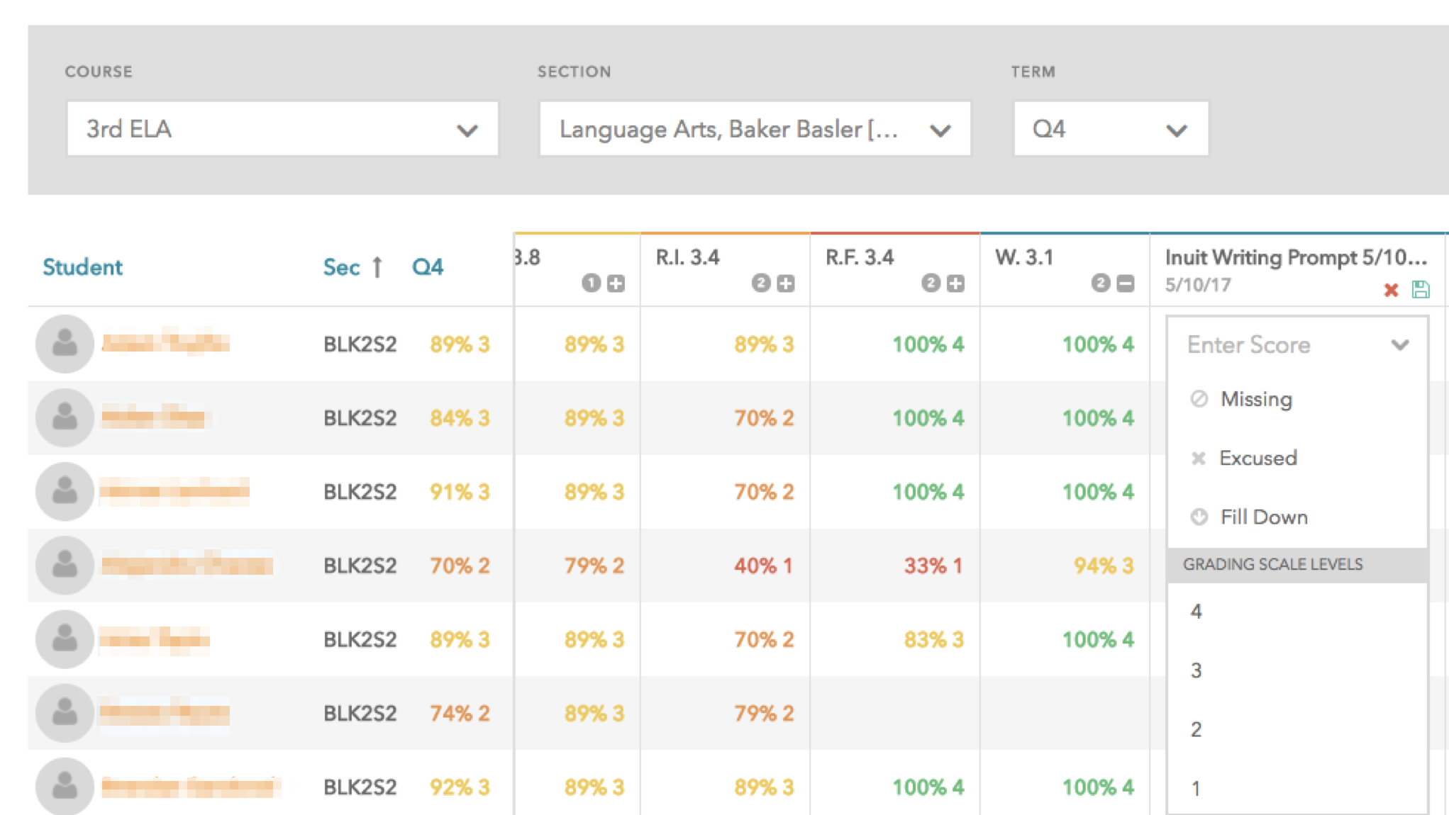
Enter assessment by overall score

Slide 65
Questions about Gradebook?

Slide 66
Practice Time: Gradebook
Navigate to the Gradebook page.
Select any course, pick a section, and the S1 term.
Click "Add Assessment" and give it a name.
Save, enter your scores out 0-100% for each student and save again!

Slide 67
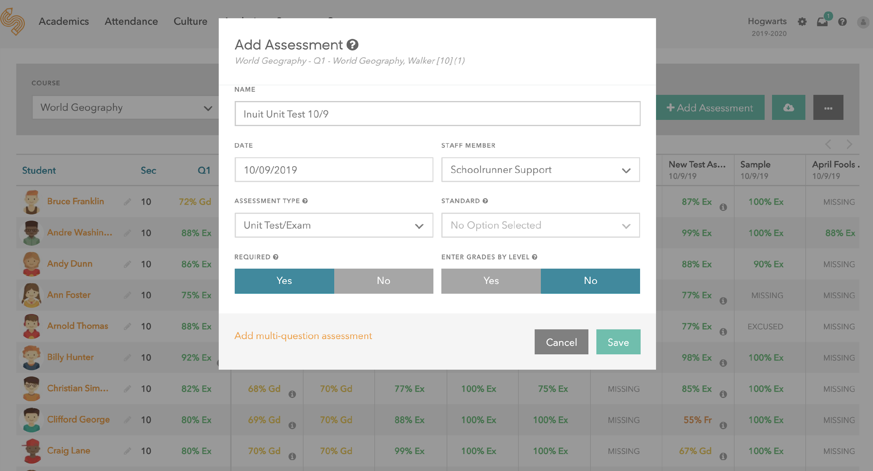
Enter assessment question-by-question
Set up your assessment the same way you just did
Then click 🡪
Notes:
Here’s where you’ll go to enter your more complex multi-question assessments out of multiple standards– can enter by level, points, or percentages

Slide 68
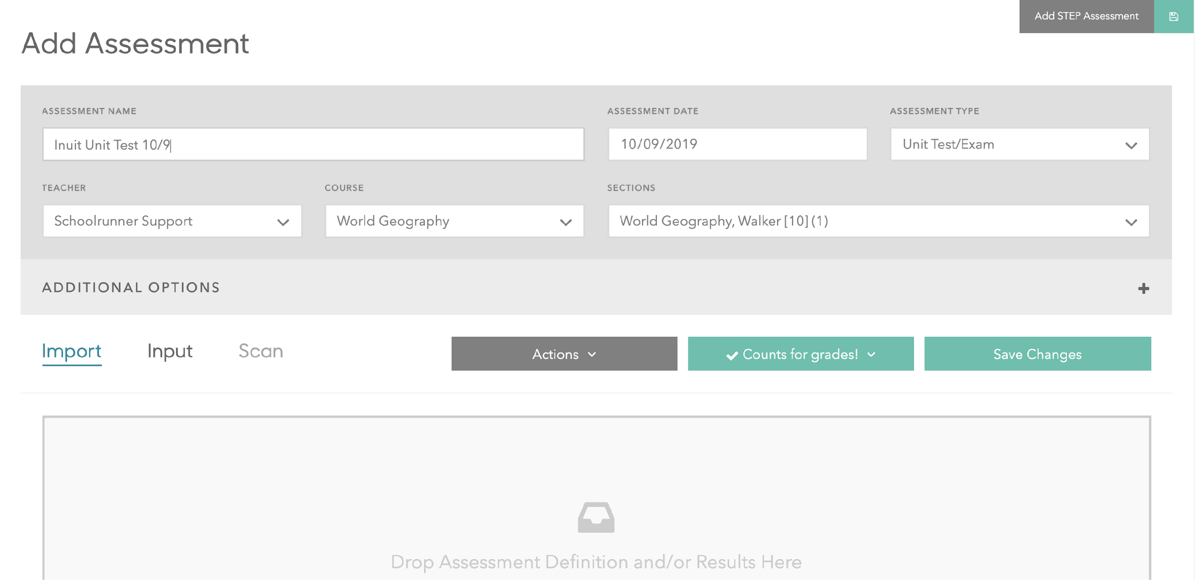
Enter assessment question-by-question
click “Input” to enter scores

Slide 69
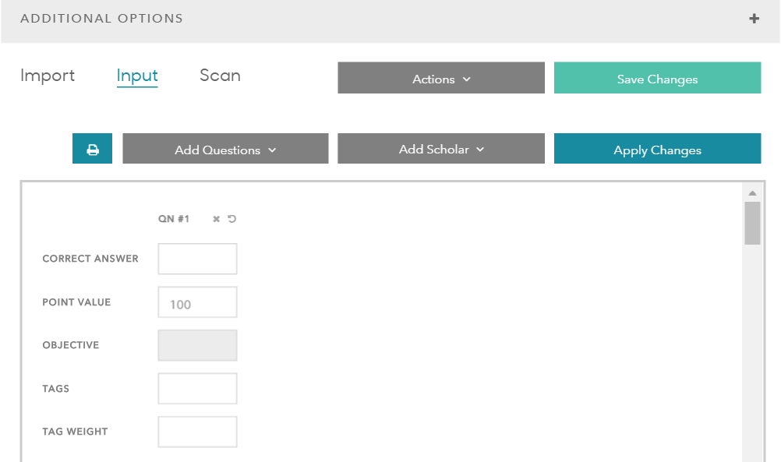
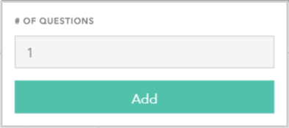
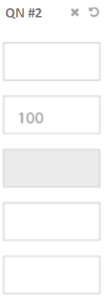
Enter assessment question-by-question
Click “Add Question” to add 1 or more question columns

Slide 70
Enter assessment question-by-question
Enter correct answer ONLY if inputting scores as multiple choice (A, B, C, D)
How many points each question is worth
These options are not used right now

Slide 71
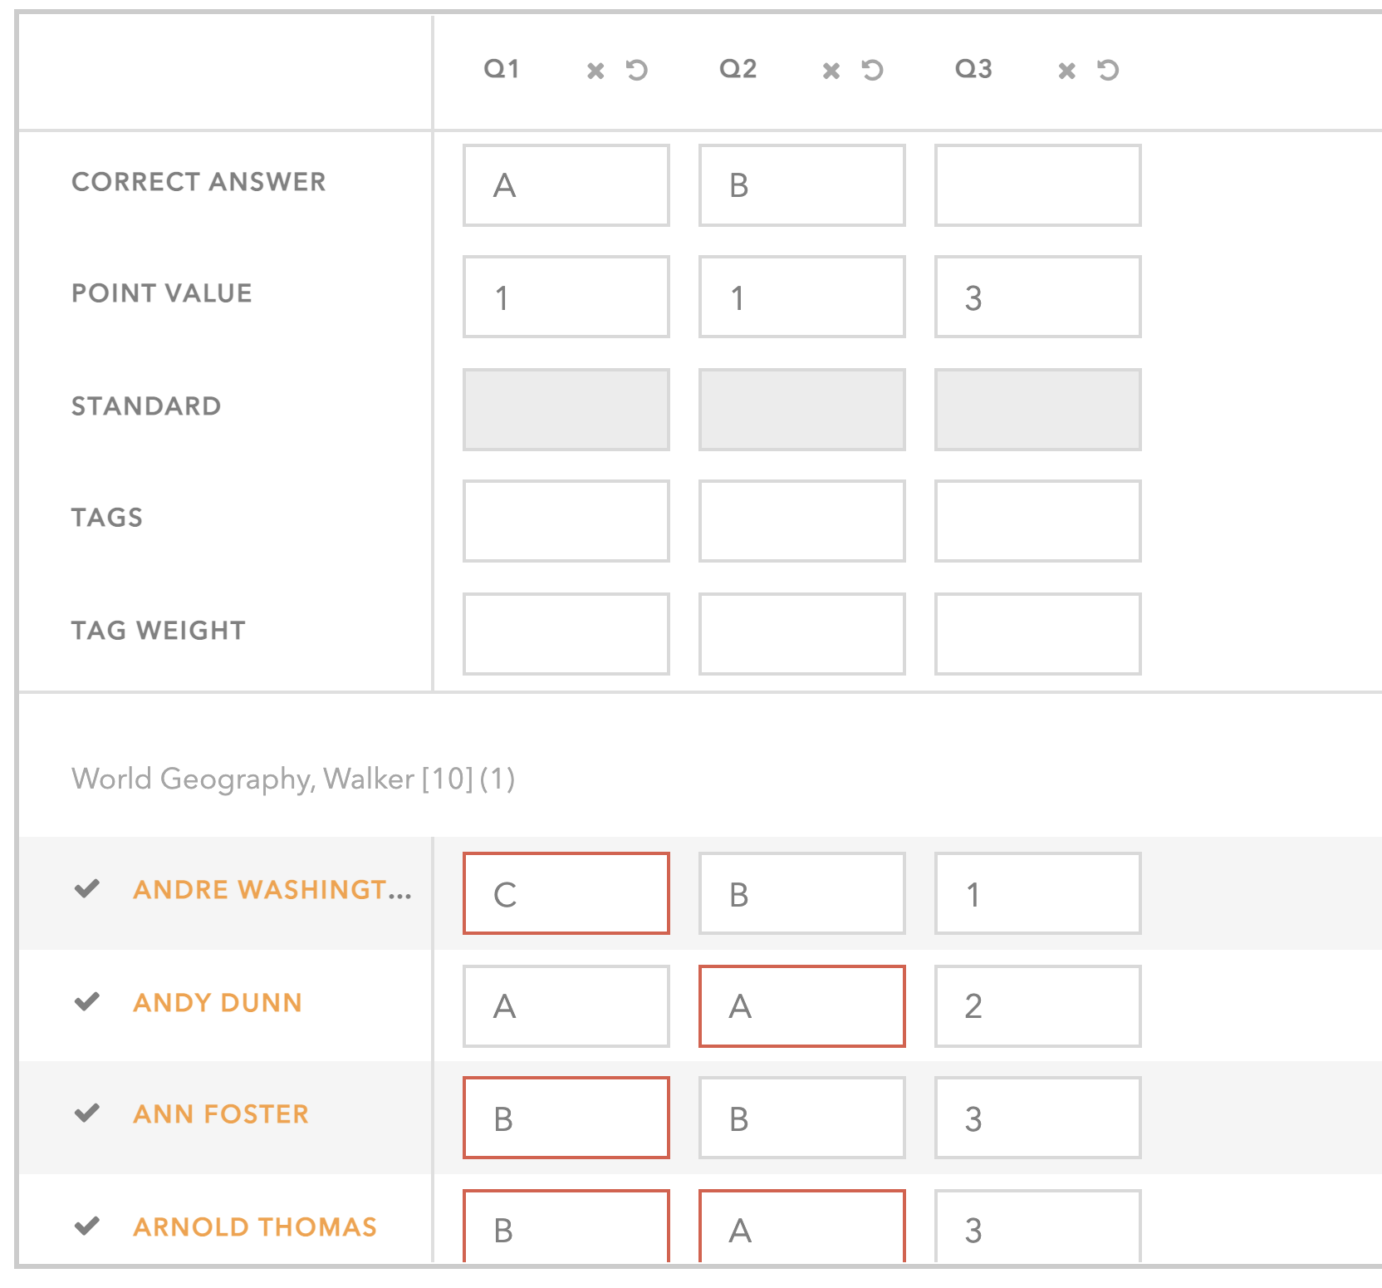
Enter assessment question-by-question
This assessment has three questions, the first two are multiple-choice questions worth 1 point; the third is a short answer question worth 3 points
Each student’s score for the first two MC questions is the MC answer they put; their score for the third SA question is out of the total points for that question

Slide 72
Enter assessment question-by-question
You can give the same grade to everyone by clicking into a score box and then clicking the down arrow
3
3
This can be helpful if most students are receiving the same score and then you can manually change the few scores that are different (may be useful for participation)
Be careful- there’s no undo button!
3
Notes:
Be careful not to say that the assessment is out of 5 points total but then give kids scores 100 or 90 or 80

Slide 73
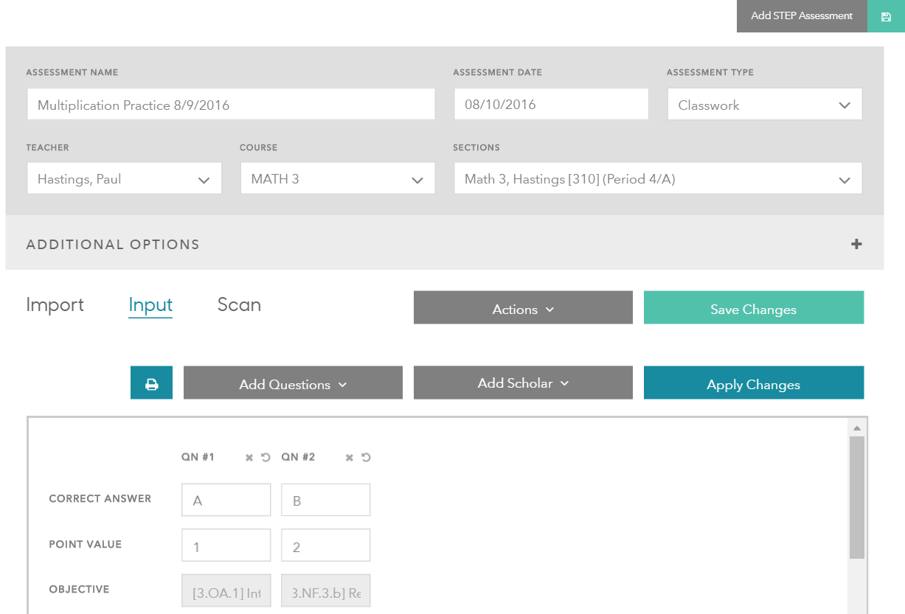
Enter assessment question-by-question
Be sure to save the assessment

Slide 74
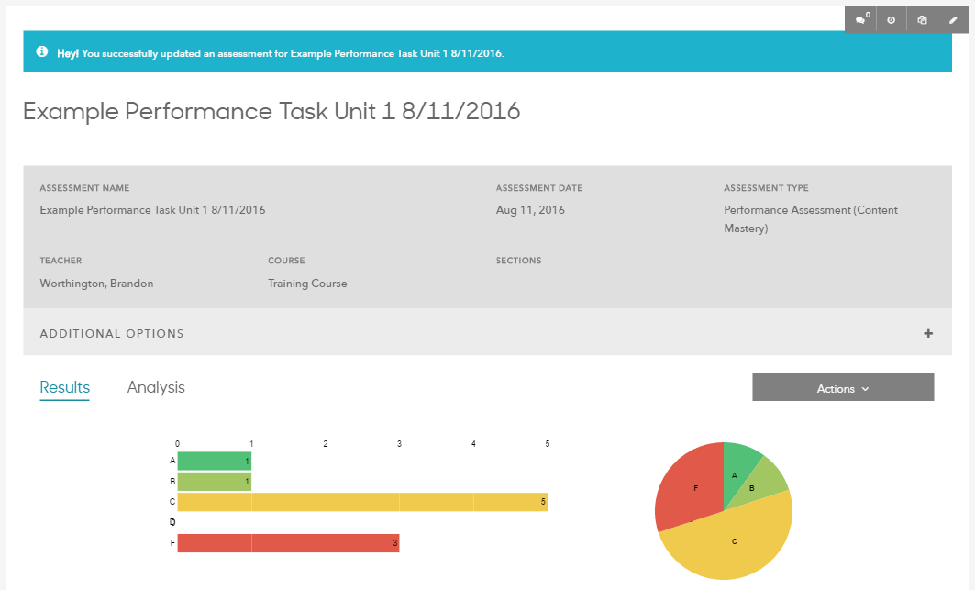
Enter assessment question-by-question
Click the pencil icon to edit the assessment or input more scores

Slide 75
Questions about inputting
scores?

Slide 76
Scanning with Gradecam
Gradecam is a program that allows you to generate bubble sheets for an assessment you’ve created in Schoolrunner and then grade the completed bubble sheets using your laptop’s built-in camera.
Gradecam will instantly enter the results into Schoolrunner for you.
Can make grading and entering assessments much more efficient.

Slide 77
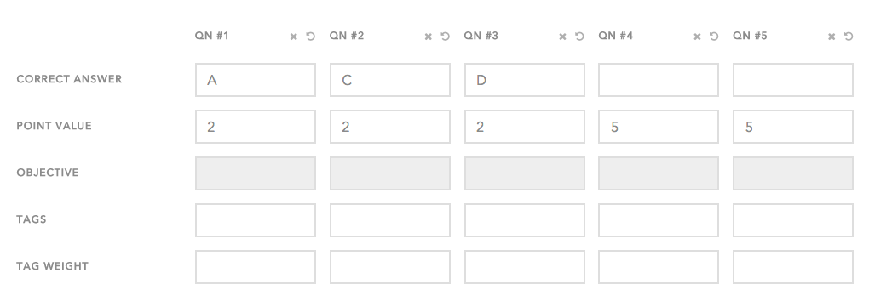
Scanning with GradeCam
Set up your assessment the same way you would for the other two methods
Click on the Input tab to determine # of q’s, correct answers, point values
For any open-ended q’s, you must instruct students to not fill in those bubbles on the bubble sheet

Slide 78
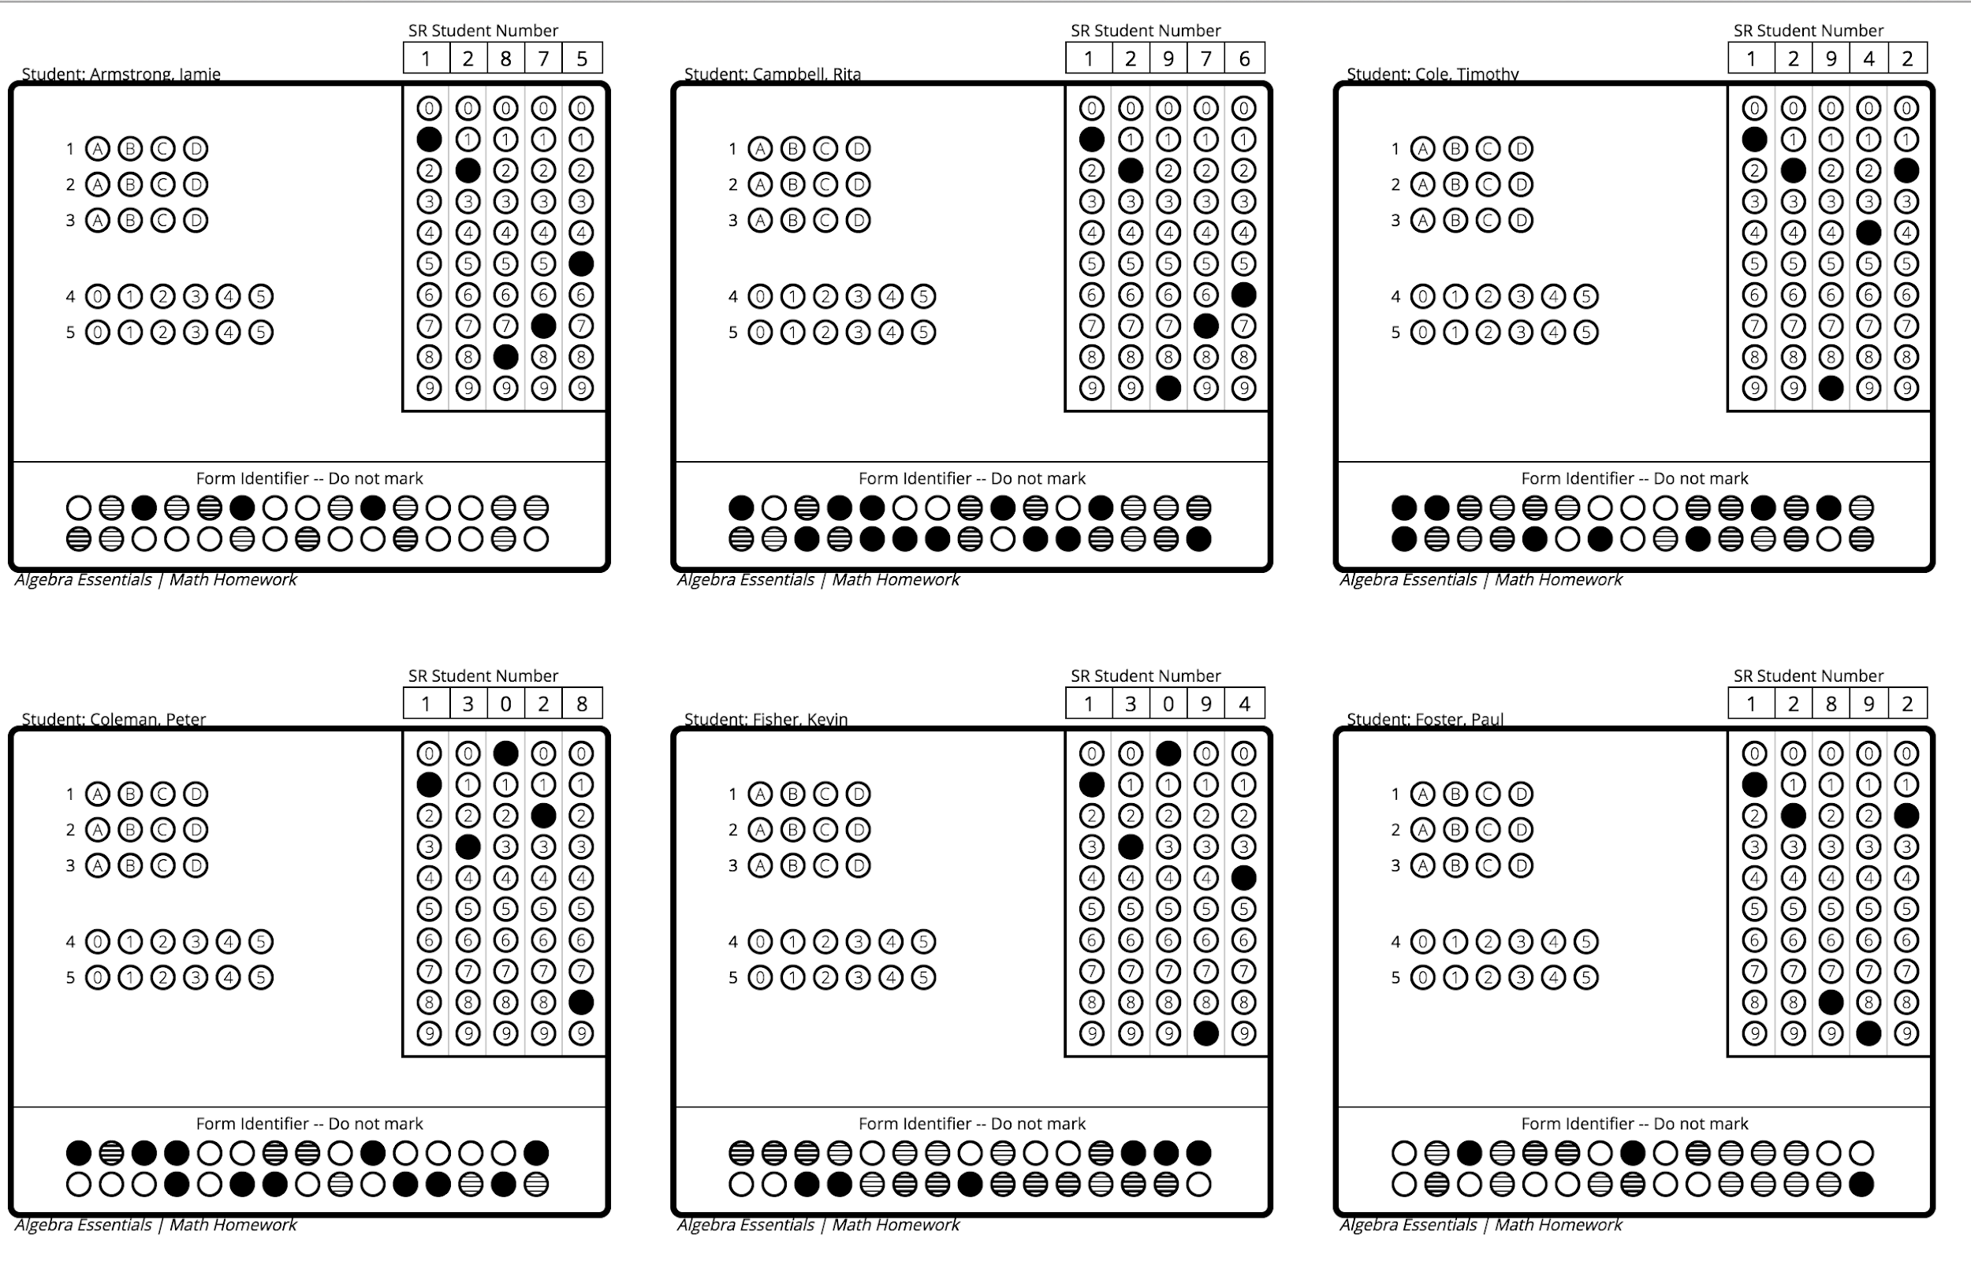
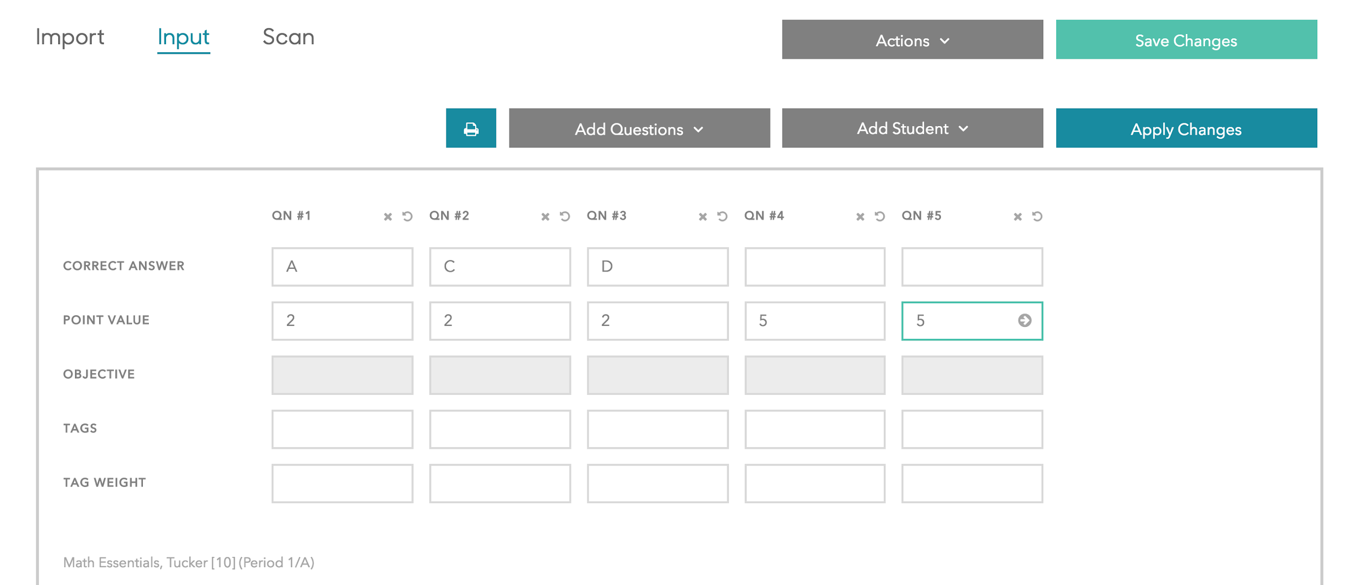
Scanning with GradeCam
When you’re done setting up your assessment, click the Print Bubble Sheets button
Notes:
If not many q’s, bubble sheets will print multiple to a page. Use scissors or a paper-cutter to cut them up. DON’T print double-sided!!

Slide 79
Scanning with GradeCam
Administer the assessment to your students! Once they’re done…

Slide 80
Finding & Editing Assessments
To pull up an assessment after it has been saved, search for its name at the top of the screen or go to “Academics” 🡪 “Assessments”

Slide 81
Finding & Editing Assessments
Will automatically pull up all of your assessments, but can also filter by assessment name, course, etc.

Slide 82
Finding & Editing Assessments
Click the pencil icon to edit the assessment or input more scores

Slide 83
Scanning with GradeCam
Press Scan

Slide 84
Scanning with GradeCam
Hold answer sheets up to webcam one by one. When you get a green check, you’ll know a sheet has scanned in correctly

Slide 85
Questions about Gradecam?

Slide 86
Practice Time: Add Assessment Page
Navigate to the Add Assessment page and set up an assessment just like you did on the Gradebook page.
Make it out of 3 questions- one multiple-choice out of 1 point, one short answer out of 2 points, and another short answer out of 5 points.​
Give students scores for each question​ and save your assessment.
Extension: Use the Assessments page (or Quick Search) to find your assessment!

